Slide 1
Week 1a : Introduction

Slide 2
This class
Contents of this course
Evaluation of this course
Some bureaucracy
Get our hands dirty with Unity

Slide 3
Contents of this course
What are you all hoping to learn in this course?

Slide 4
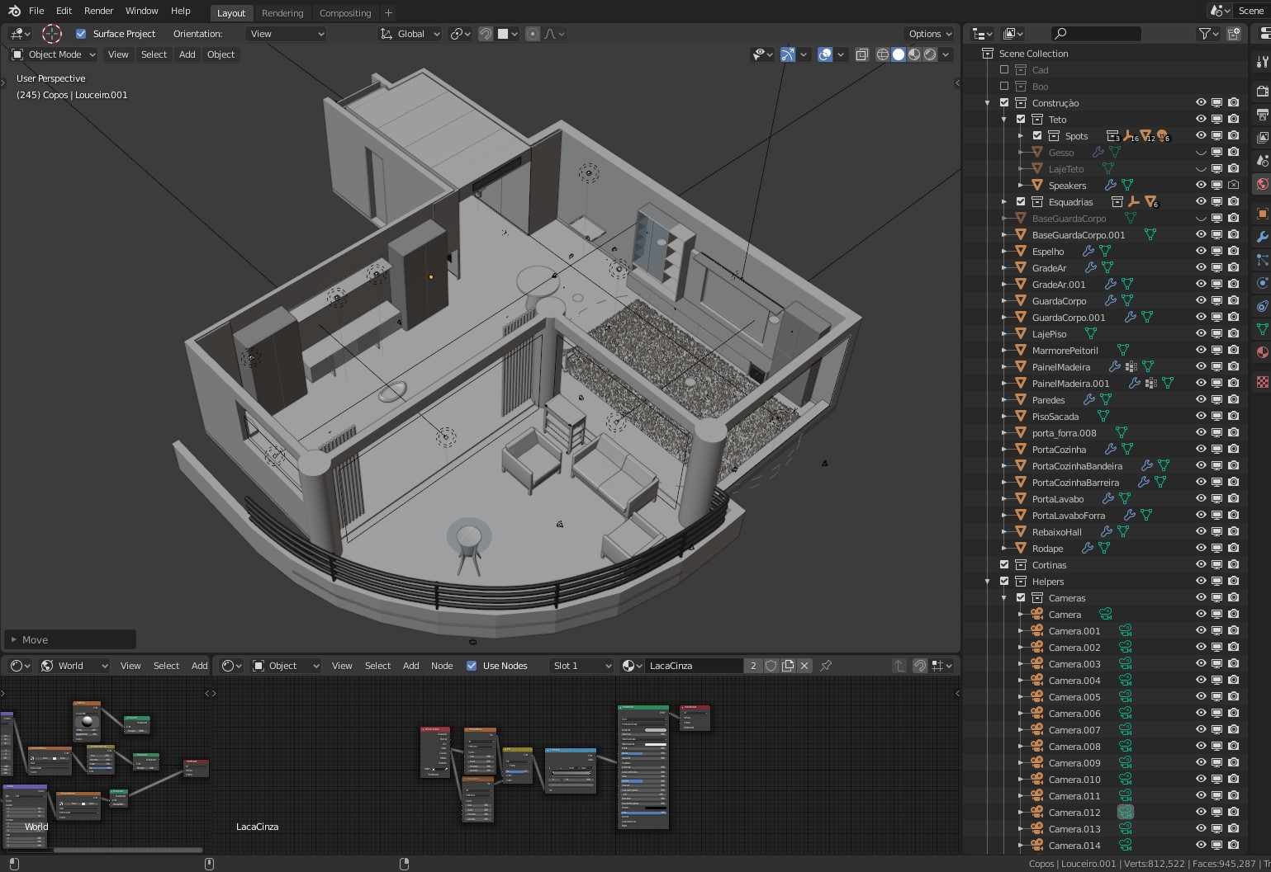
What are “3D graphics”?
“Images representing a 3d scene created by transforming 3d models and textures using algorithms”
This is not *the* definition, this is my definition
It’s a badly defined term

Slide 5
Creating 3D graphics
We need to create 3D models : 3D modeling
We need to create textures : Texturing
We need to create a scene : World Building
We need to transform them : ??? Does anyone know the term ???

Slide 6
This course should be called 3D rendering
Rendering : creating an image, based on a description of a scene, using algorithms
Description is models, textures, animations, camera settings… and a bunch of other stuff
“graphics programming” would also be a good name for this course

Slide 7


There are two kinds of rendering
Does anyone know the difference?

Slide 8
There are two kinds of rendering
Movie
Game

Slide 9
There are two kinds of rendering
Game Do calculations continuously
Why?
Offline rendering Do calculations once

Slide 10
There are two kinds of rendering
(offline) rendering
Realtime rendering

Slide 11
What is the big difference?
How long do we have to render the frame? Assume we’re rendering 60 frames per second (fps)

Slide 12
What is the big difference?
60 frames per second
1 second / 60
16.6 ms per frame

Slide 13
What is the big difference?
How long do we have to render the frame?
Movies display at least 24 fps

Slide 14
What is the big difference?
How long do we have to render the frame?
Movies display at at least 24 fps

Slide 15
Trick question! It doesn’t matter
We only need to render once (no user input)
Anecdotally, about 80-400 hours on a single pc for one frame, but is always rendered on a farm

Slide 16
This course should be called “realtime 3D rendering”
We need to learn how to make 3D images
We need to use the graphics card (GPU) to do it fast enough

Slide 17

Course schedule
 | Monday | Thursday
Week 1 : 12/02 | Introduction | C#/Unity Lab
Week 2 : 19/02 | 3D reasoning | 3D Lab
Week 3 : 26/02 | Basic Pipeline | Lab
Week 4 : 04/03 | Textures Normal maps | Post processing / lab
Week 5 : 11/03 | Camera’s Light | lab
Week 6 : 18/03 | Advanced pipeline | Advanced pipeline lab
Week 7 : 25/03 | Materials Aliasing | Materials Lab
Week 8 : 15/04 | Procedural generation | Procedural generation lab
Week 9 : 22/04 | Project explanation | Project lab
Week 10 : 29/04 | Guest Lecture Project Labs | Guest Lecture Project Labs
Week 11 : | Revision | Revision

Slide 18
This might not make a lot of sense yet
We’ll do some hands one things with Unity this class and (hopefully) it will start to make more sense
Unfortunately, this will be true of this course as well. Rendering is a lot of simple seperate parts, that only make once you can make the connections

Slide 19
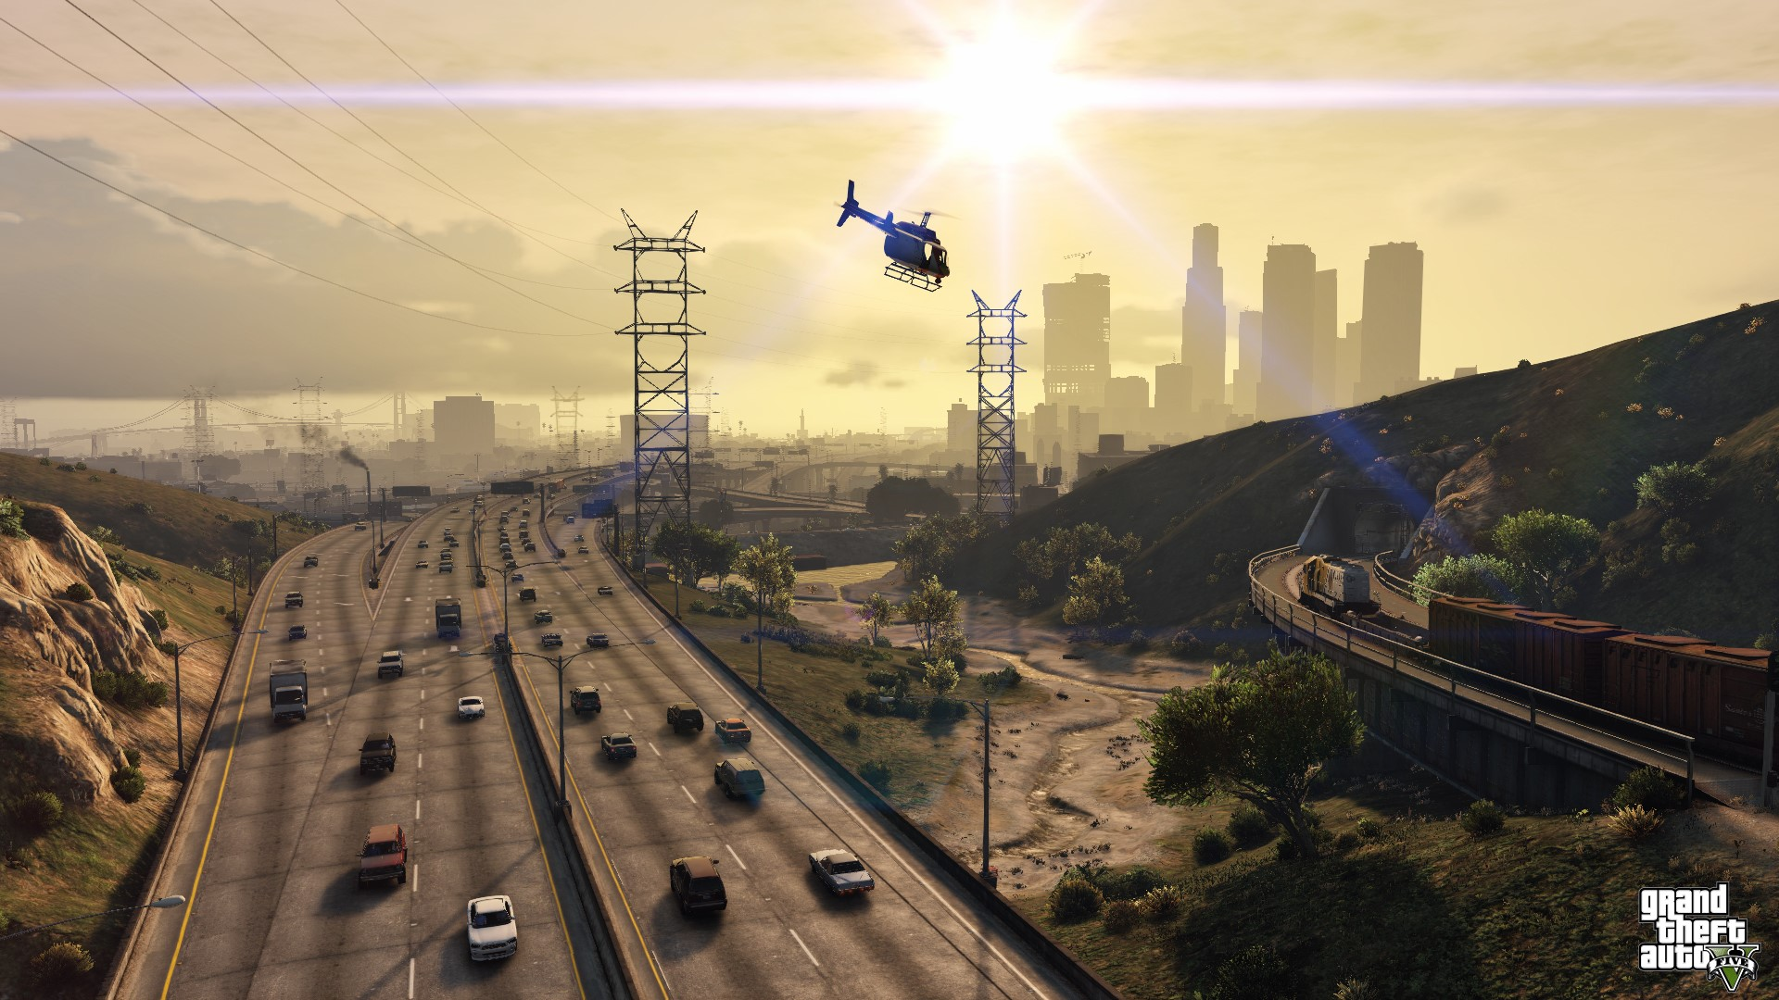
Reframe: we want to understand why a pixel has it’s color

Slide 20
We will need to learn
3D geometry

Slide 21
This class
Contents of this course
→ Evaluation of this course ←
Some bureaucracy
Get our hands dirty with Unity

Slide 22
Evaluation of this course
8 points on lab exercises
12 points on project
Oral exam defending both
Danger : oral exam checks you understand what you did in the exercizes and project. It a defence, but it’s also an oral exam of the theory as you used it.

Slide 23
Lab exercises
Multiple short exercises per topic
Should cover as much of the course as is possible
Where an exercise is impossible, I will provide a quiz to check your progress

Slide 24
This class
Contents of this course
Evaluation of this course
→ Some bureaucracy ←
Get our hands dirty with Unity

Slide 25

Contacting me : send me an email!
I usually respond in 3 or 4 working
I might miss you on Toledo or Teams, just send me an email
I never get enough emails from my students

Slide 26
This class
Contents of this course
Evaluation of this course
Some bureaucracy
→ Get our hands dirty with Unity ←

Slide 27
Our tech stack

Slide 28
Why Unity?
Most popular game engine on the market
C# is a low barrier to entry (Unreal uses C++)
Useful for other courses

Slide 29
Why not Unity?
Closed source
Hides what we’re interested in
Maybe we would like to do things ourself

Slide 30
Recap
This course teaches you how 3d rendering works
Specifically, realtime 3d rendering

Slide 31
Next week

